Slide 1

Networking and Security: Protecting Our Connected World
A critical overview of the modern cybersecurity landscape and the essential strategies for securing digital infrastructure.
Presented By
Name: Karanveer Singh
UID: 25BCA10227
Class: 25BCA 2 (A)

Slide 2





Why Network Security Matters Today
Global Reliance
Over 4 billion internet users globally rely on secure networks daily for everything from commerce to communication and critical services.
Economic Impact
Cyberattacks are projected to cost the global economy nearly $10 trillion annually by 2025, highlighting the scale of financial risk.
Expanding Attack Surface
Every new device connected to the network—from smartphones to smart sensors—is a potential, vulnerable entry point for attackers.

Slide 3






The Core Goals of Network Security: The CIA Triad
These three fundamental principles are the foundation for any robust security framework, protecting all digital assets.
Integrity
Ensuring that data is authentic, accurate, and has not been altered or tampered with by unauthorized parties during transmission or storage.
Confidentiality
Keeping data private and secret through techniques like advanced encryption and strict access controls.
Availability
Guaranteeing that authorized users can consistently access network resources and critical services when needed, preventing downtime.
These pillars protect everything from personal emails to proprietary corporate data and critical national infrastructure.

Slide 4




Common Network Threats You Must Know
Understanding the most frequent attack vectors is the first step in building adequate defenses.
Malware and Ransomware
Malicious software like viruses, worms, and ransomware designed to disrupt operations, steal data, or demand payment for release.
Phishing Attacks
Deceptive emails or messages that trick users into revealing confidential information such as passwords, banking details, or corporate secrets.
Denial of Service (DoS)
Overwhelming a network, service, or website with traffic from multiple sources (DDoS) to cause outages and make resources unavailable to legitimate users.
Man-in-the-Middle (MITM)
Interception and relaying of communication between two parties, allowing the attacker to secretly listen in or alter the communication path.

Slide 5


Case Study: The Supply Chain Risk
SolarWinds Attack (2020-2024)
Attackers compromised the software update mechanism for SolarWinds' Orion platform, a popular network management tool.
The malicious code was unknowingly distributed to over 18,000 organizations worldwide, including Fortune 500 companies and U.S. government agencies.
The breach led to the exposure of highly sensitive government and corporate data over several months before detection.
This incident highlighted the extreme vulnerability inherent in the software supply chain and the need for rigorous security vigilance for third-party tools.

Slide 6
Authentication and Access Control: Who Gets In?
Implementing layered verification steps is crucial to validating user identity and limiting access privileges.
One-Factor Authentication (1FA)
Typically relies on a single secret, like a password. While still widely used, it is highly vulnerable to brute-force and phishing attacks.
Two-Factor Authentication (2FA)
Requires two distinct forms of proof (e.g., password + phone code or biometric scan). Significantly enhances security by making accounts harder to compromise.
Multi-Factor Authentication (MFA)
Requires two or more verification methods. MFA is considered the industry standard for strong identity protection in enterprise environments.
Role-Based Access Control (RBAC)
Limits user permissions strictly based on their organizational role (e.g., Admin vs. Guest). This principle of least privilege minimizes internal risk.

Slide 7

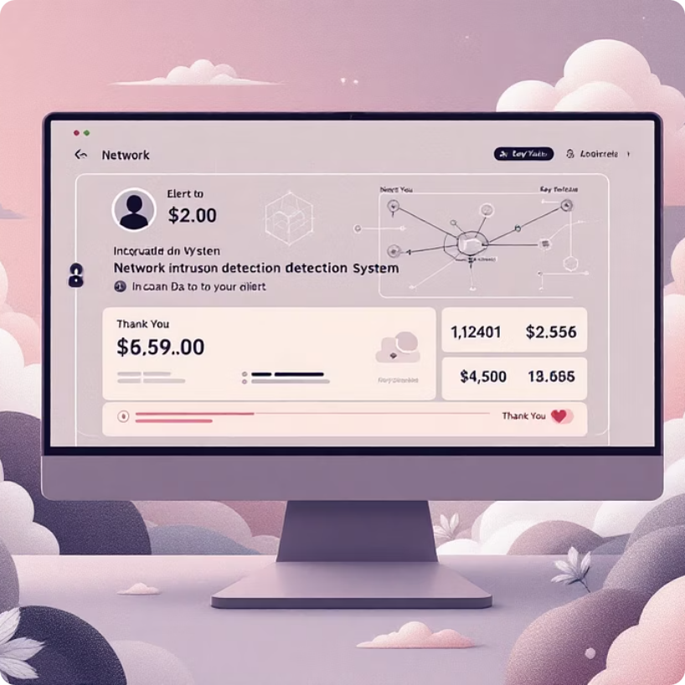


Essential Network Defense Technologies
A layered defense strategy requires a variety of tools working in concert to monitor, filter, and protect data transmission.
Firewalls
Intrusion Detection Systems (IDS)
Virtual Private Networks (VPNs)
WPA3 Encryption
Act as intelligent gatekeepers, filtering incoming and outgoing network traffic based on a defined set of security rules and policies.
The modern encryption standard for wireless security, offering enhanced protection against eavesdropping and dictionary attacks on Wi-Fi networks.
Continuously monitor network traffic for malicious activity or policy violations, alerting administrators to suspicious patterns in real-time.
Create an encrypted tunnel across public networks, ensuring secure remote access and data privacy for traveling or remote employees.

Slide 8





Best Practices to Secure Your Network
Proactive maintenance and continuous user education are as vital as the technology itself.
Maintain Updates
Regularly apply software patches, firmware updates, and security fixes to eliminate known vulnerabilities before they can be exploited.
Strong Credentials & MFA
Enforce the use of strong, unique passwords across all systems and mandate multi-factor authentication for elevated security.
Minimize Attack Surface
Disable or uninstall unnecessary network services, applications, and ports that could serve as unmonitored entry points for attackers.
User Training
Educate all users to recognize and report sophisticated social engineering and phishing tactics.

Slide 9





Emerging Challenges and Future Directions
Perimeter Security
Zero Trust
Continuous verification for every request
Traditional firewall and VPN defenses
Layered Controls
Emerging Threats
Network segmentation and access policies
IoT, AI attacks and quantum risks
IoT Expansion: The proliferation of Internet of Things devices massively increases network complexity and introduces hard-to-patch vulnerabilities.
AI-Powered Defense: Future defenses must leverage AI and machine learning to detect and respond to increasingly sophisticated, automated AI-driven attacks.
Zero Trust Architecture: This model, based on the principle "Never trust, always verify," requires strict verification for every user and device, regardless of location.
Quantum Threat: The emergence of quantum computing could potentially break current public-key encryption, requiring a major shift to post-quantum cryptography.

Slide 10

Conclusion: Securing Our Digital Future Together
Shared Responsibility
Proactivity is Key
Network security is not just an IT issue—it requires continuous effort and adherence to protocols from individuals, businesses, and government bodies.
We must remain proactive, staying informed about evolving threats and adapting defense strategies to counter the dynamic nature of cybercrime.
Layered Defense
Invest in multiple, layered defenses—technical and human—and commit to continuous monitoring to protect the integrity and availability of critical assets.
Build a Safer, More Resilient Connected World.

Slide 11
Thank You
Thank you for your valuable time and attention to this important presentation on networking and security. Your engagement is crucial as we collectively strive to build a more secure digital environment.

